Slide 1
Introduction to
Gradient Boosting

Slide 2
Gradient Boosting
a powerful machine learning algorithm
It can do
Regression
Classification
Ranking

Slide 3

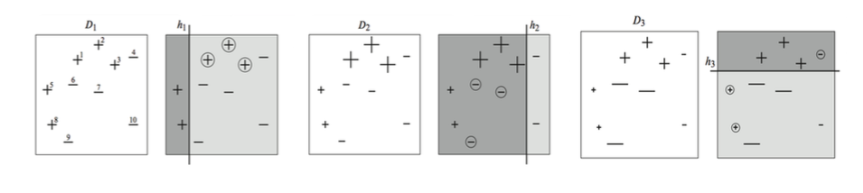
Gradient Boosting
Gradient Boosting = Gradient Descent + Boosting
Adaboost

Slide 4
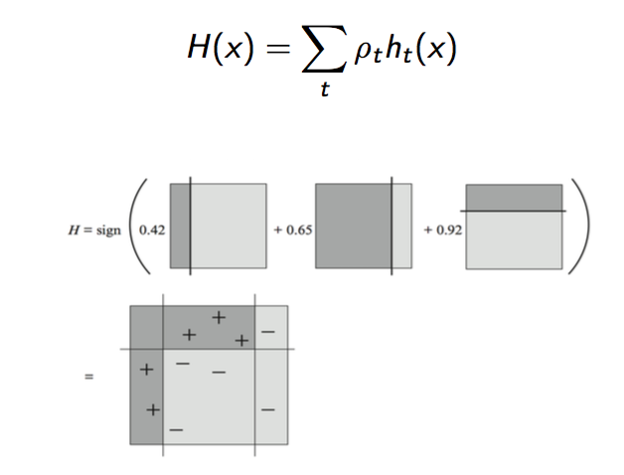

Adaboost
Notes:
https://zh.wikipedia.org/wiki/AdaBoost

Slide 5

Fit an additive model in a forward stage-wise manner.
In each stage, introduce a weak learner to compensate the shortcomings of existing weak learners.
In Gradient Boosting,“shortcomings” are identified by gradients.
Recall that, in Adaboost,“shortcomings” are identified by high-weight data points.
Both high-weight data points and gradients tell us how to improve our model.
Notes:
a是關於誤差的表達式，提高錯誤點的權值，當下一次分類器再次分錯了這些點之後，會提高整體的錯誤率，這樣就導致 a 變的很小，最終導致這個分類器在整個混合分類器的權值變低。也就是說，這個算法讓優秀的分類器占整體的權值更高，而錯的分類器權值更低。

Slide 6
A Brief History of Gradient Boosting
Invent Adaboost, the first successful boosting algorithm
Formulate Adaboost as gradient descent with a special loss function
Generalize Adaboost to Gradient Boosting in order to handle a variety of loss functions

Slide 7


given (x1, y1), (x2, y2), ..., (xn, yn), and fit a model F(x) to minimize square loss.
add an additional model (regression tree) h to F, new prediction will be F (x ) + h(x ).
Then
yi − F (xi ) are called residuals. These are the parts that existing model F cannot do well. The role of h is to compensate the shortcoming of existing model F.

Slide 8

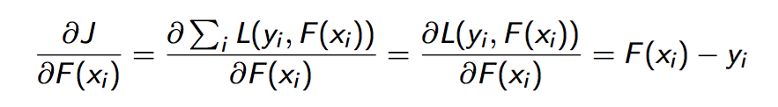
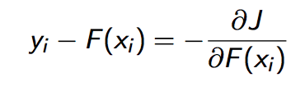
Loss function L(y , F (x ))
minimize J = L(yi , F (xi )) by adjusting F(x1),F(x2),...,F(xn)
treat F(xi) as parameters and take derivatives
interpret residuals as negative gradients.

Slide 9
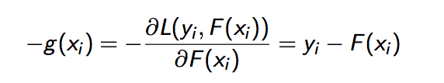



Summarize the algorithm we just derived:
Start with an initial model, say,
Iterate until converge:
calculate negative gradients
fit a regression tree h to negative gradients −g(xi)
F := F + ρh, where ρ = 1
It allows us to consider other loss functions and derive the corresponding algorithms in the same way.

Slide 10
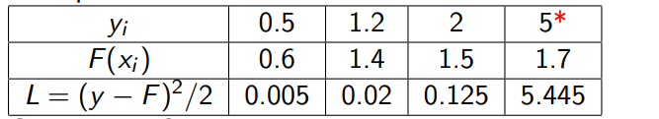
Loss Functions for Regression Problem
Square loss is:
√ Easy to deal with mathematically.
× Not robust to outliers.
According to the square loss function:
Outliers are heavily punished because the error is squared.

Slide 11

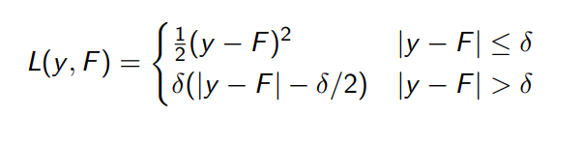
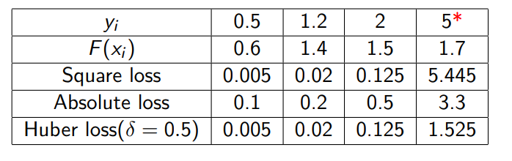
Absolute loss (more robust to outliers)
Huber loss (more robust to outliers)

Slide 12


For any loss function, we can derive a gradient boosting algorithm...
Regression with Absolute Loss
Negative gradient:
Start with an initial model, say,
Iterate until converge:
calculate gradients −g(xi)
fit a regression tree h to negative gradients −g(xi)
F := F + ρh

Slide 13
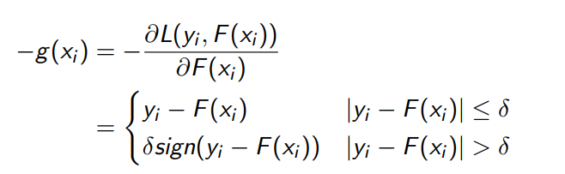
Regression with Huber Loss
Negative gradient:
Start with an initial model, say,
Iterate until converge:
calculate gradients −g(xi)
fit a regression tree h to negative gradients −g(xi)
F := F + ρh

Slide 14
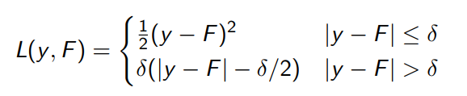

In general, negative gradients ⇔ residuals.
For example:
Huber loss:
Update by Negative Gradient:
Update by Residual:
Negative gradient pays less attention to outliers, so we should follow negative gradients rather than residuals.

Slide 15

Gradient Boosting for Classification
Problem
Recognize the given hand written capital letter.
Multi-class classification
26 classes. A,B,C,...,Z
Data set
http://archive.ics.uci.edu/ml/datasets/Letter+ Recognition

Slide 16
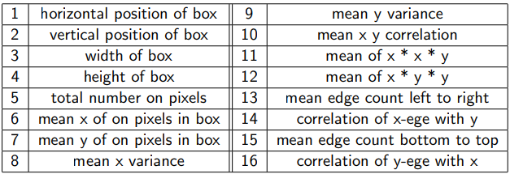
Feature Extraction
20000 data points, 16 features
Feature Vector= (2, 1, 3, 1, 1, 8, 6, 6, 6, 6, 5, 9, 1, 7, 5, 10) Label = G

Slide 17
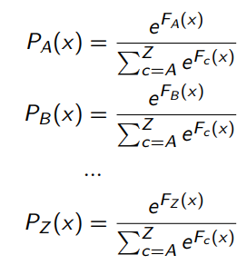
Model
26 score functions (our models):F_{A}, F_{B} , F_{C}, ..., F_{Z} . F_{A}(x) assigns a score for class A scores are used to calculate probabilities:
predicted label = class that has the highest probability

Slide 18
Loss Function for each data point Step 1 turn the label y_{i} into a (true) probability distribution Yc (x_{i}) For example: y5=G, Y_{A}(x5) = 0, Y_{B} (x5) = 0, ..., Y_{G} (x5) = 1, ..., Y_{Z} (x5) = 0
Step 2 calculate the predicted probability distribution Pc (x_{i}) based on the current model F_{A}, F_{B} , ..., F_{Z} . P_{A}(x5) = 0.03, P_{B} (x5) = 0.05, ..., P_{G} (x5) = 0.3, ..., P_{Z} (x5) = 0.05
Step 3 calculate the difference between the true probability distribution and the predicted probability distribution. Here we use KL-divergence

Slide 19
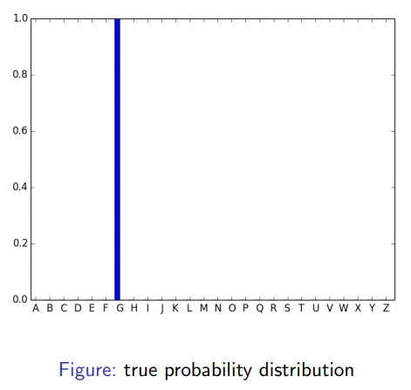
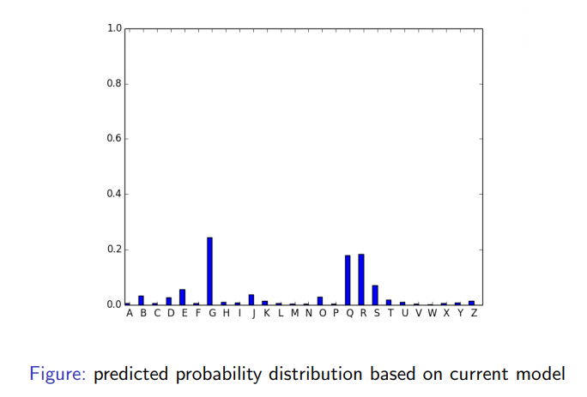

Slide 20
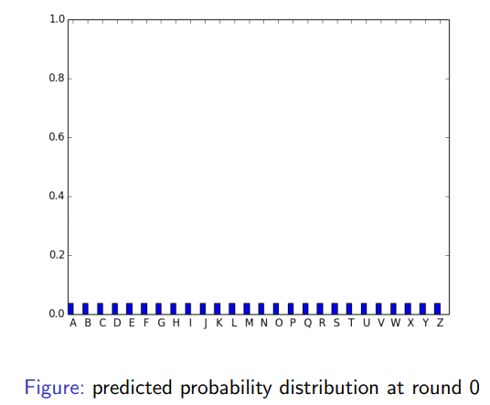
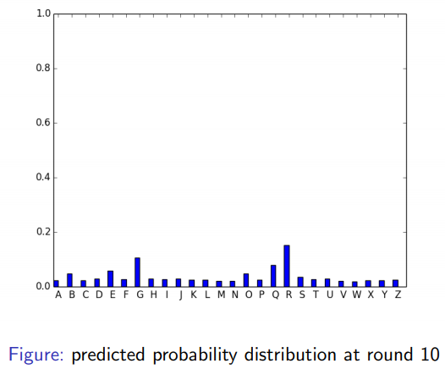
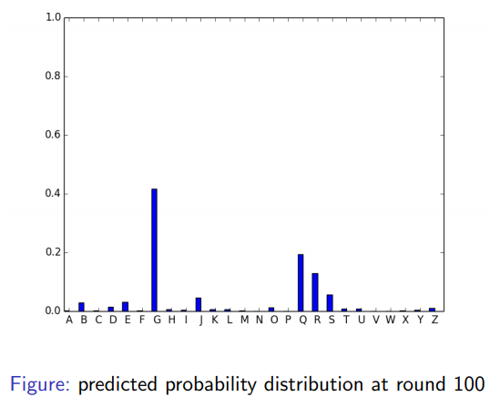
Goal
minimize the total loss (KL-divergence)
for each data point, we wish the predicted probability distribution to match the true probability distribution as closely as possible
we achieve this goal by adjusting our models F_{A}, F_{B} , ..., F_{Z} .

Slide 21
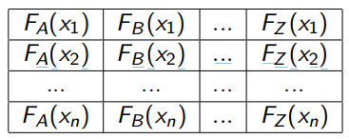
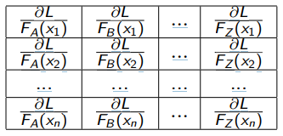
Differences Between GB Regression and Classification
F_{A}, F_{B} , ..., F_{Z} vs F a matrix of parameters to optimize vs a column of parameters to optimize
a matrix of gradients vs a column of gradients

Slide 22
start with initial models F_{A}, F_{B} , F_{C} , ..., F_{Z}, iterate until converge:
calculate negative gradients for class A: −g_{A}(xi) = Y_{A}(xi) − P_{A}(xi) calculate negative gradients for class B: −g_{B} (xi) = Y_{B} (xi) − P_{B} (xi) ... calculate negative gradients for class Z:−g_{Z} (xi) = Y_{Z} (xi) − P_{Z} (xi)
fit a regression tree hA to negative gradients −g_{A}(xi) fit a regression tree hB to negative gradients −g_{B} (xi) ... fit a regression tree hZ to negative gradients −g_{Z} (xi)
F_{A} := F_{A} + ρ_{A}h_{A} ... F_{Z} := F_{Z} + ρ_{Z} h_{Z}

Slide 23
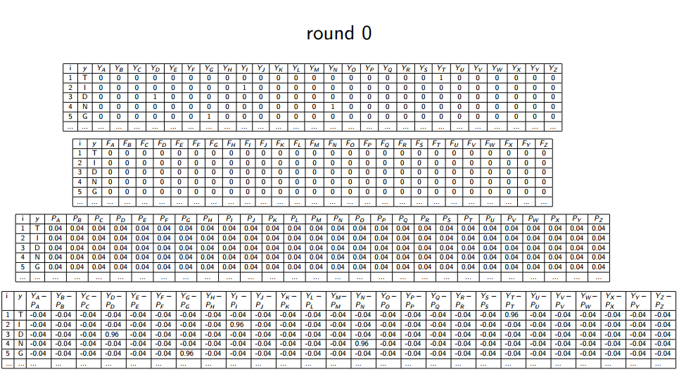

Slide 24
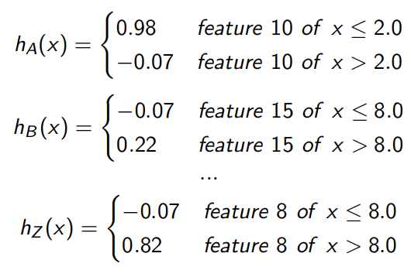
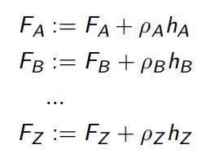

Slide 25
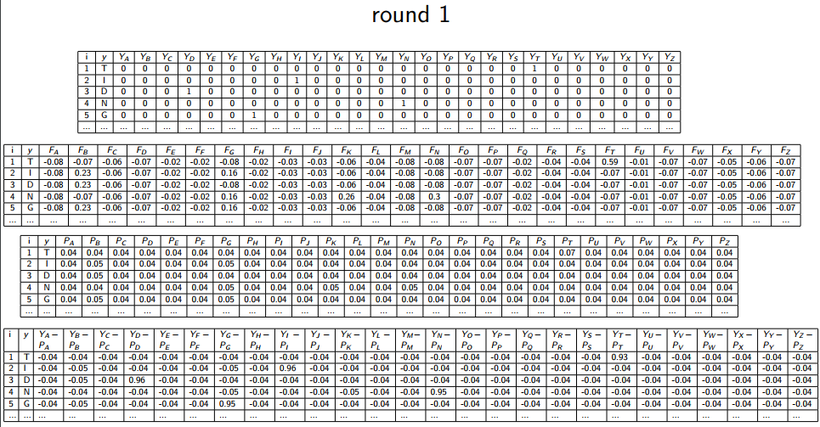

Slide 26
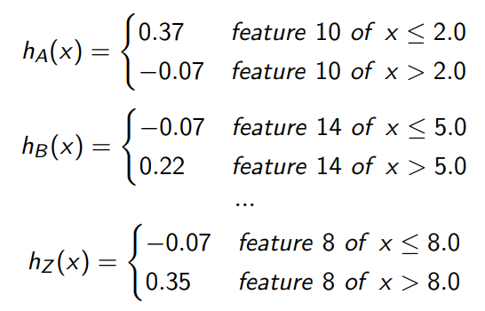
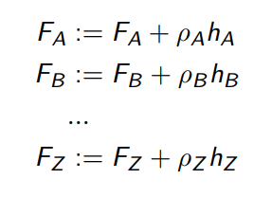

Slide 27
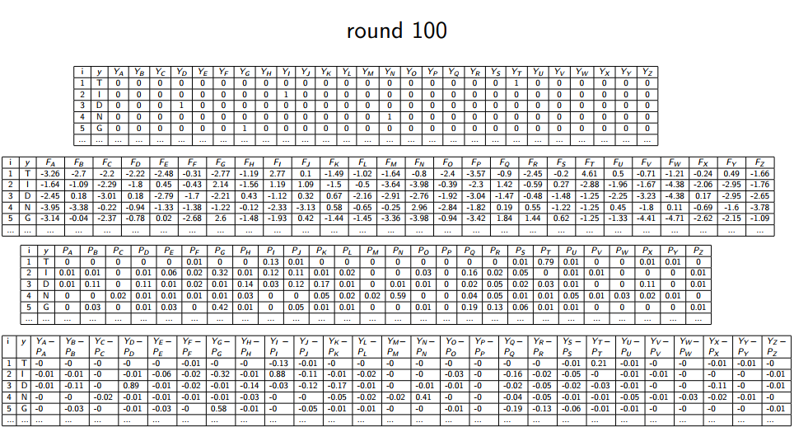

Slide 28
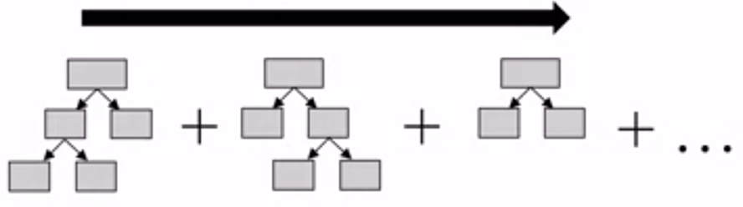
Gradient Boosting Decision Tree
Training builds a series of small decision trees.
Each tree attempts to correct errors from the previous stage.
The learning rate controls how hard each new tree tries to correct remaining mistakes from previous round.
High learning rate: more complex trees
Low learning rate: simpler trees

Slide 29
GBDT：Pros
Often best off-the-shelf accuracy on many problems
Using model for prediction requires only modest memory and is fast
Doesn’t require careful normalization of features to perform well
Like decision trees, handles a mixture of feature types
Notes:
off the shelf: 現成的；買來不用改就用的

Slide 30
GBDT：Cons
Like random forests, the models are often difficult for humans to interpret
Requires careful tuning of the learning rate and other parameters
Training can require significant computation
Like decision trees, not recommended for text classification and other problems with very high dimensional sparse features, for accuracy and computational cost reasons

